Slide 1
Used for highlighting a key portion of portion of the user interface
Menus
Used for highlighting a step (step 2 in this example)
2
All screenshots from PowerPoint taken with zoom level in PowerPoint at 100%
All screenshots from other applications are scaled to 75% in PowerPoint. Other scales can be used when necessary for clarity.
User Task
Decision
Yes
Program Task
Start
End
No
+
Fork/Join

Slide 2
Start
Select Region (where)
Select Keyword(s)
(what)
Select Time Period
(when)
Select Source(s)
(who)
Run Search
Download Data
End

Slide 3
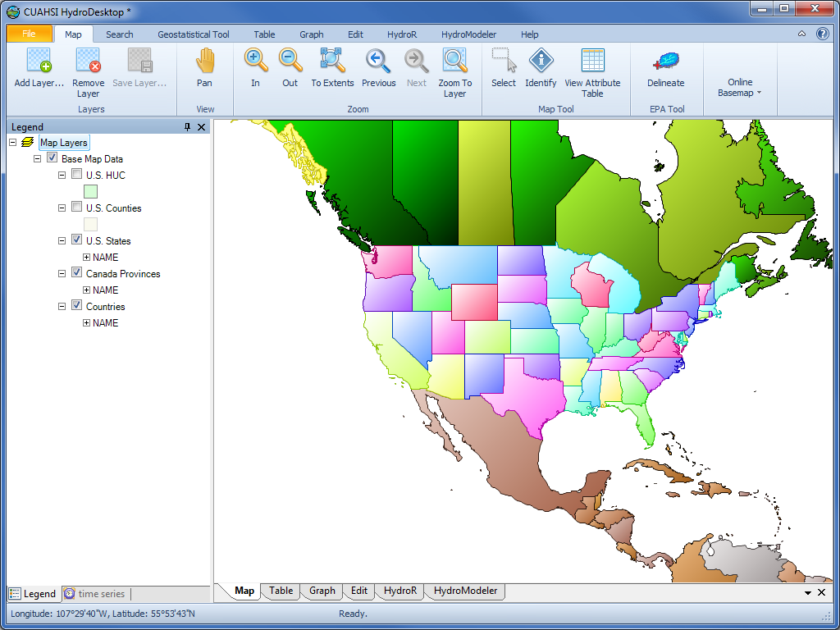
Ribbon
Legend
Map

Slide 4
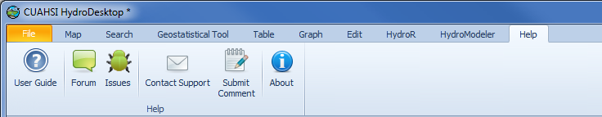
3
4

Slide 5
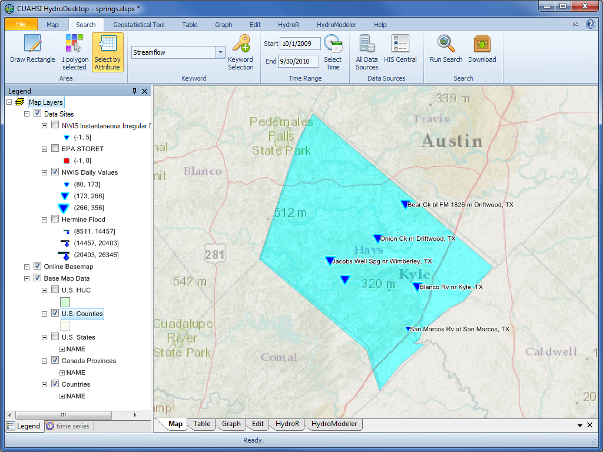

Slide 6
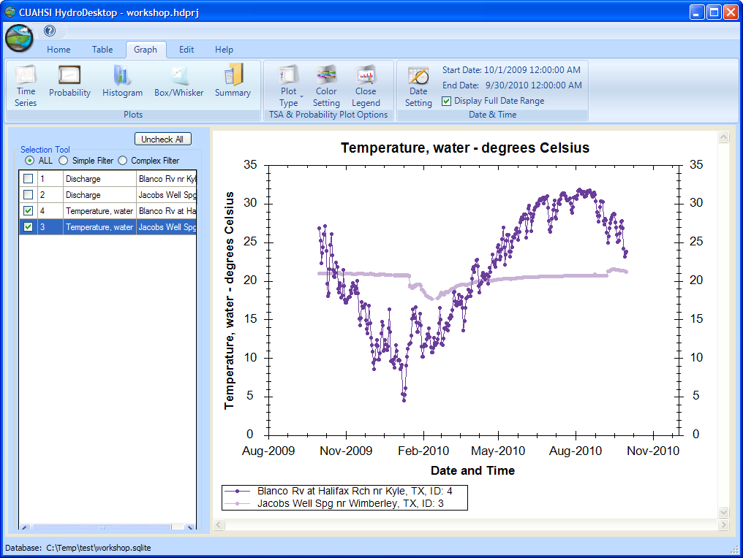
2
3

Slide 7
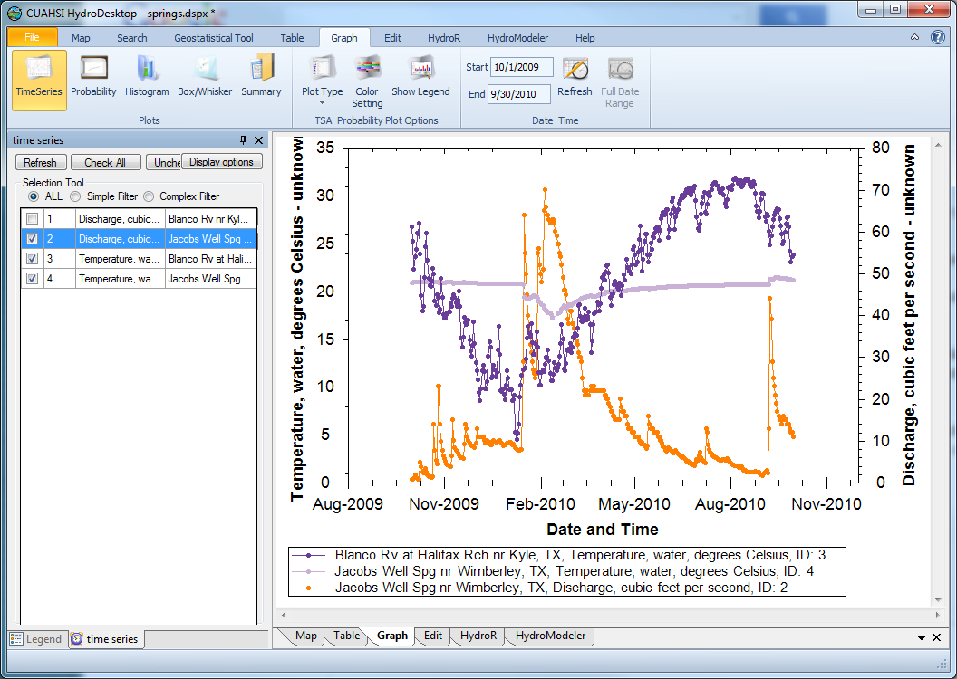
Flow increase
Temperature drop

Slide 8
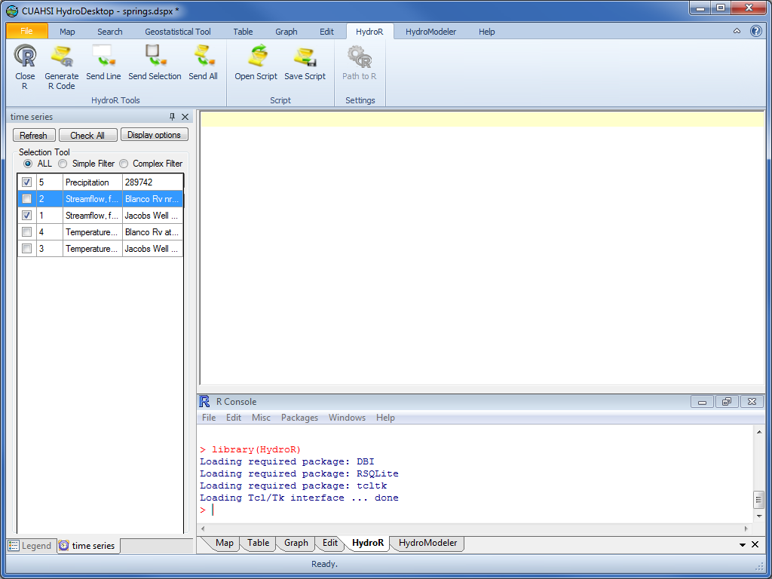
R script panel
Series Selector
R Console

